Slide 1
Chapter 1: Introduction
1.1. Images and Pictures
An image is worth thousands of word

Slide 2
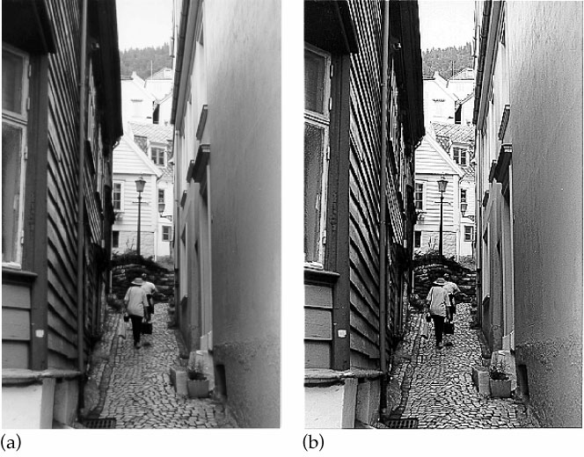
1.2 Image processing – change the nature of an image
Objectives: (a) Human interpretation
(b) Machine perception
Human interpretation
Image sharpening

Slide 3
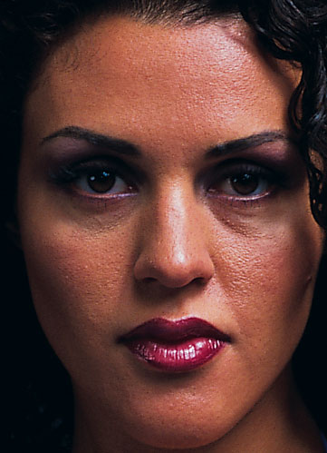
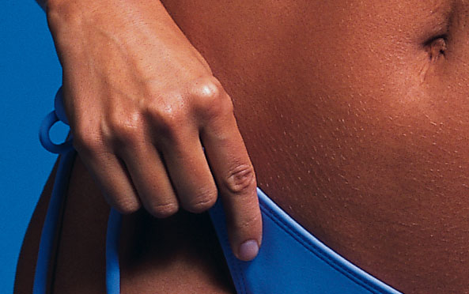
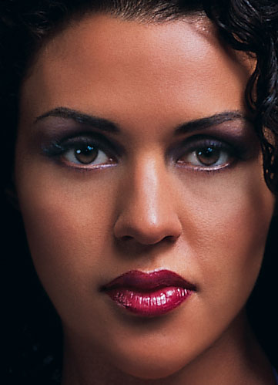

Before
After

Slide 4
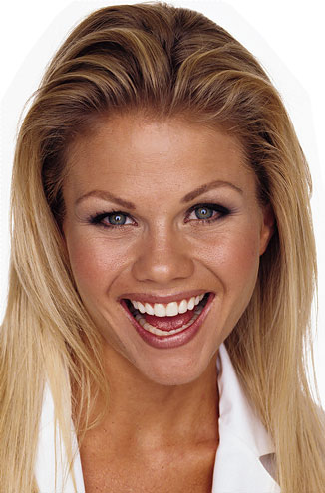
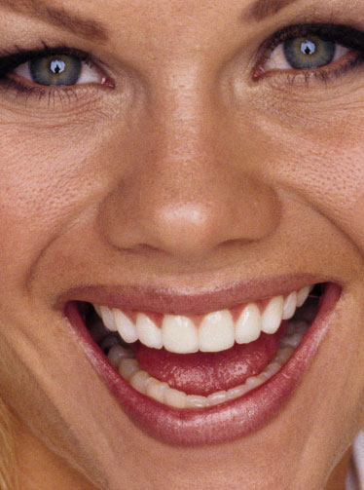
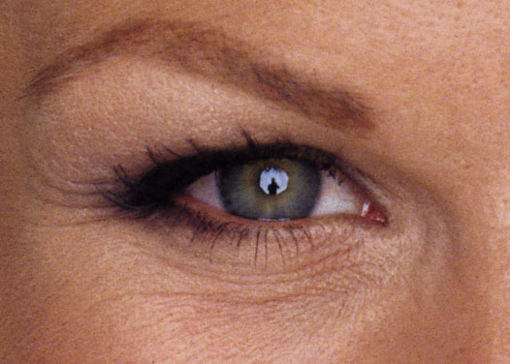
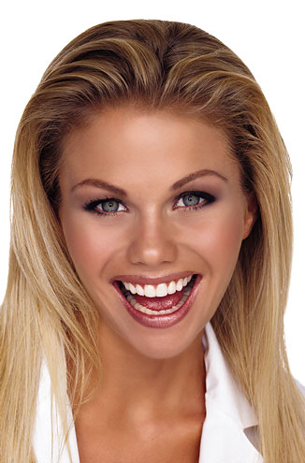
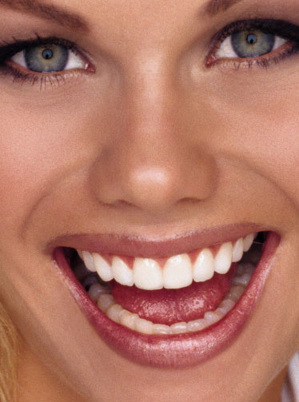
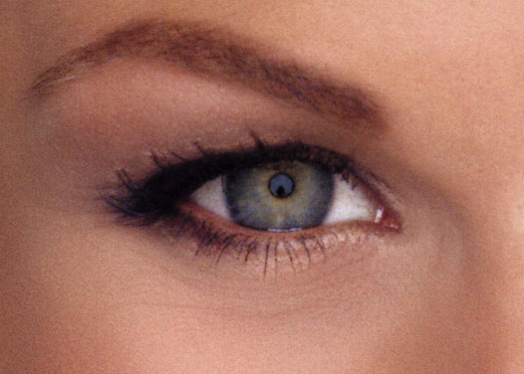
Before
After

Slide 5
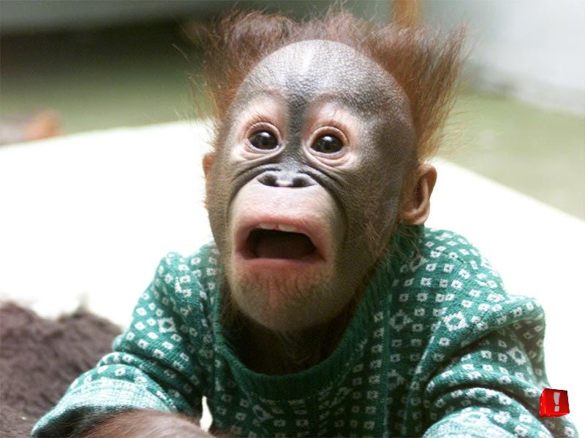

For you, . . . not much can be done!

Slide 6
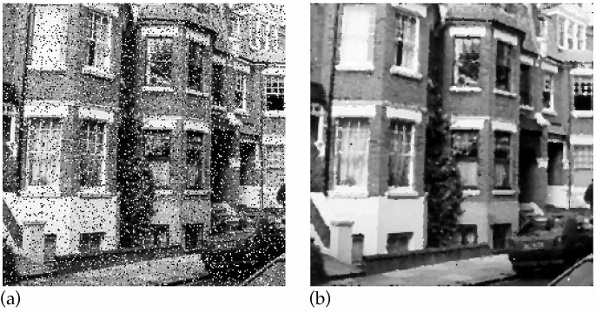
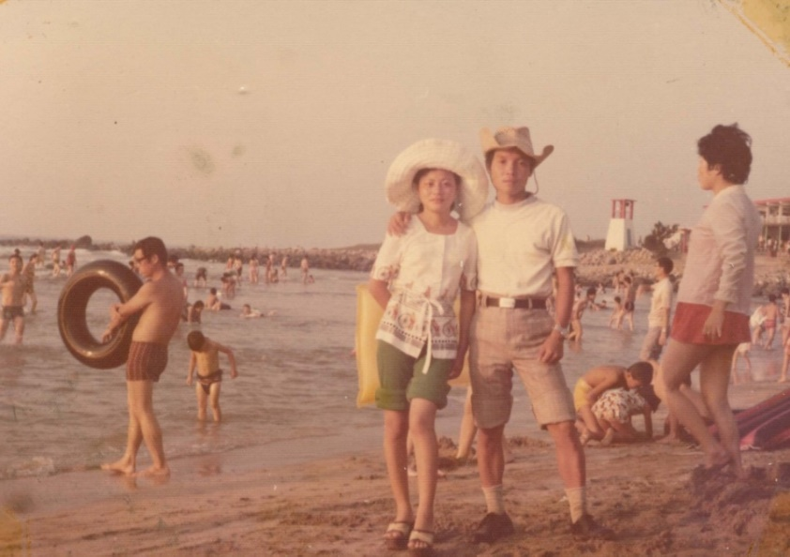
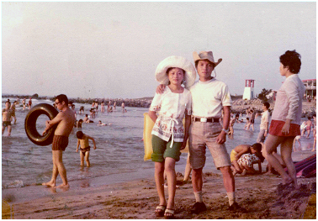
Noise removal
Deblurring

Slide 7
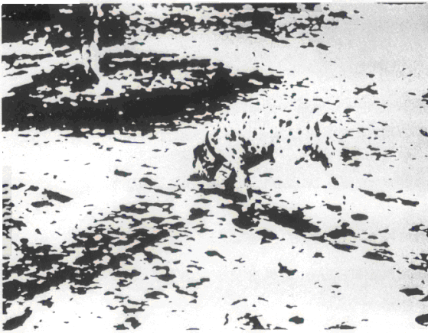


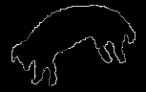


(B) Machine perception
Example: scene understanding
Thresholding, Noise removal
Group ─ form significant regions
Cluster ─ associate with objects
Segment ─ locate primary areas
Edge detection , Edge following
. . . . . . . . . . . . .
Input image
Edge detection
Edge following
Segmentation
Grouping,
Clustering
Thresholding

Slide 8
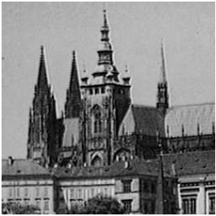
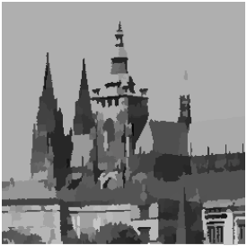
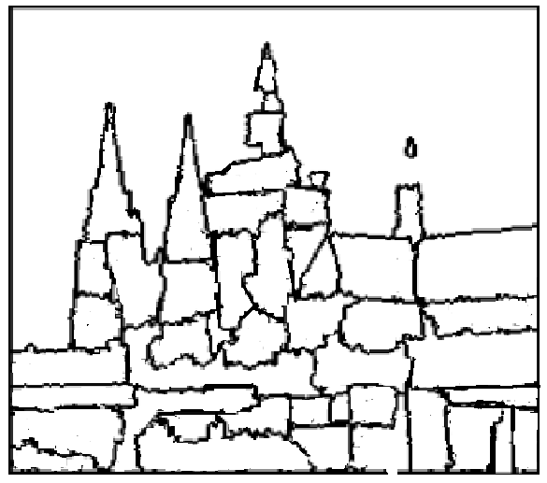
Input image
Image segmentation
Edge detection
1-8

Slide 9
Three levels of image processing:
Low-level processing –
e.g., threshold, noise removal (smoothing)
contrast enhancement (sharpening)
Mid-level processing –
e.g., grouping, clustering,
edge detection, image segmentation
High-level processing –
e.g., object recognition
scene understanding

Slide 10
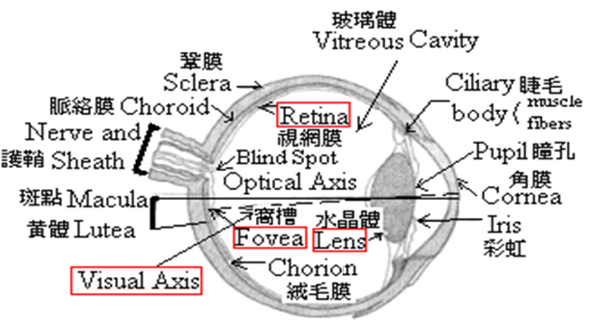
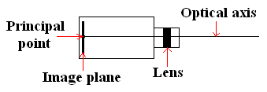
1.3.1 Image Acquisition
1.3 Image Acquisition and Sampling
Human eye
Cameras

Slide 11
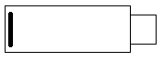
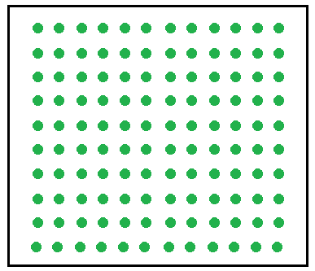
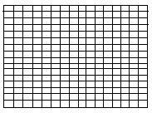
Digital cameras
CCD (charge-coupled device) cameras,
CMOS (complementary metal oxide
semiconductor) camera
Image
plane
Sensor array
Image array

Slide 12
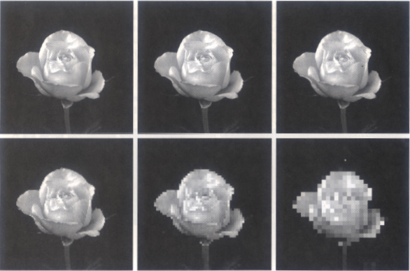
1.3.2 Sampling
-- transforms a continuous function into a discrete one
Spatial Resolution

Slide 13
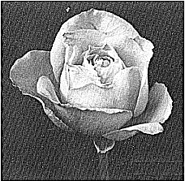
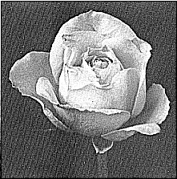
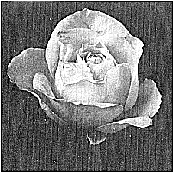
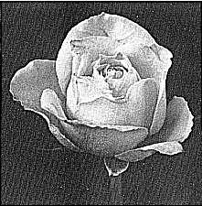
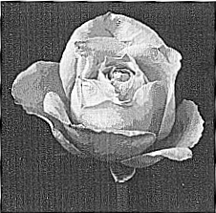
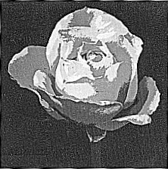
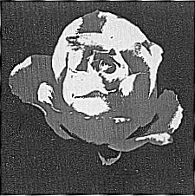
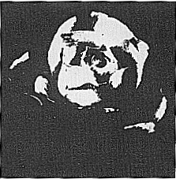
Grayscale resolution (Quantization)
False contours

Slide 14
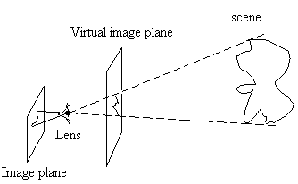
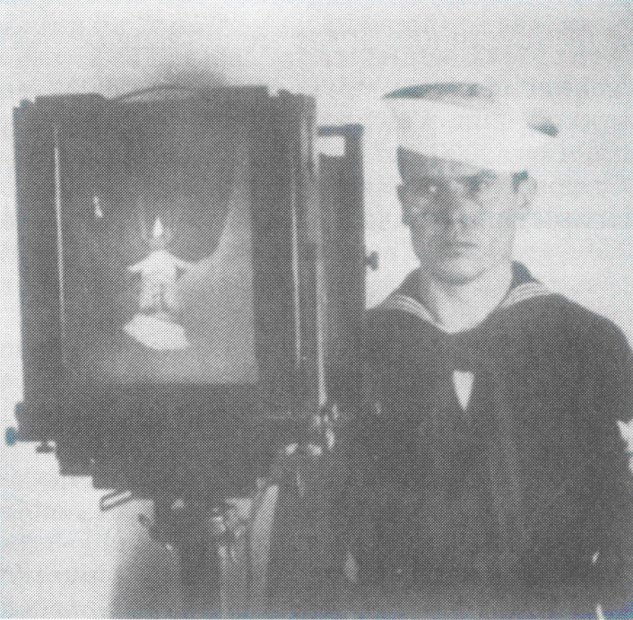
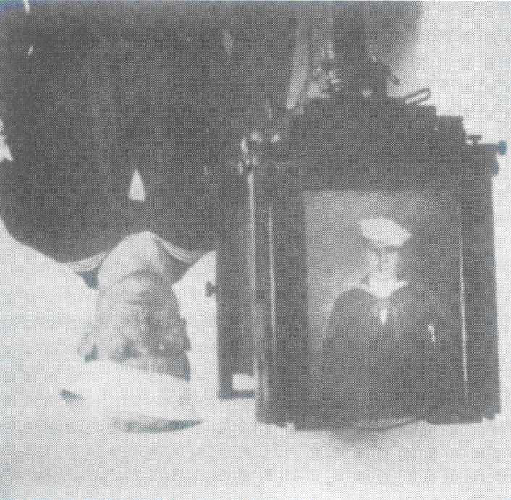
1.4 Images and Digital Images
Imaging model

Slide 15
Scene: a 3-D continuous function, g(x,y,z)
Image: a 2-D continuous function, f(x,y)
Digital image: a 2-D discrete function, I(r,c)
Origin
○
c
r
Pixel: picture element
Gray level: pixel value (0 – 255)

Slide 16
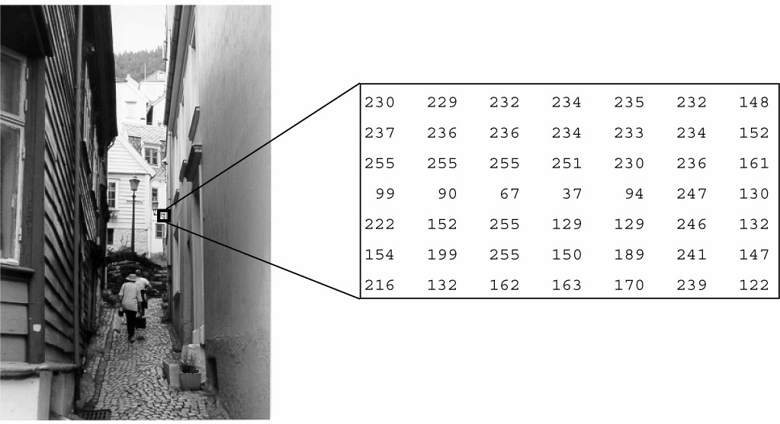
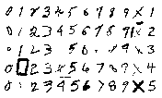
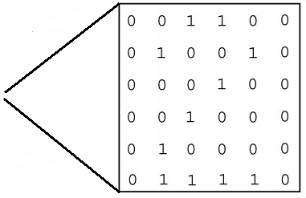
1.8 Types of Digital Images
Grayscale image
Binary image

Slide 17
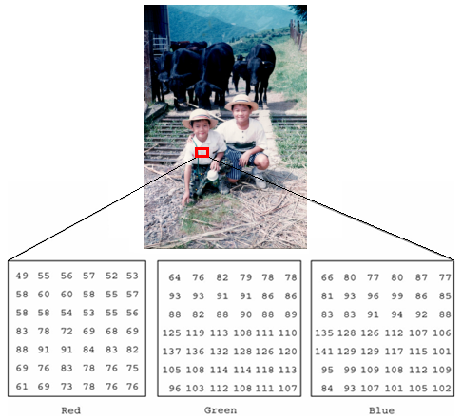
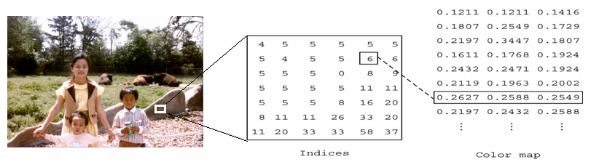
Color image
Indexed (or palette) color image

Slide 18
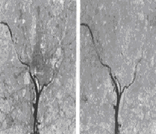
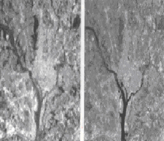
Multispectral images

Slide 19
Radio images

Slide 20
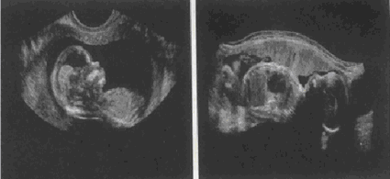
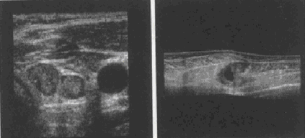
Ultrasound images

Slide 21
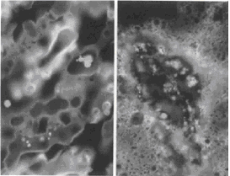
Ultraviolet images

Slide 22
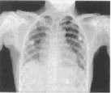
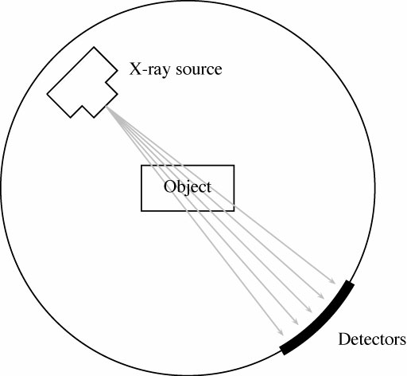
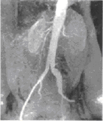
X-ray image

Slide 23
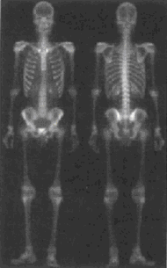

Gamma-ray images

Slide 24
X-ray transmission computerized tomography (CT) image

Slide 25






Range images

Slide 26



Moire images

Slide 27

Structure light images

Slide 28





Slide 29
Biological images
Cattles
Horses
Chickens
Owls
Bees, Flies, Grasshoppers
Snakes
Fishes

Slide 30
Examples: i) 512 by 512 binary image:
1.9 Image File Sizes
ii) 512 by 512 greyscale image:
iii) 512 by 512 color image:

Slide 31



-- Limitations of human visual system
1.10 Image Perception
Simultaneous
contrast
Optical
illusion

Slide 32



Overshoot and Undershoot
Subjective
objects

Slide 33

1-33

Slide 34

1-34

Slide 35

1-35

Slide 36

1-36

Slide 37

1-37

Slide 38

1-38

